Slide 1
SE 2101 Software Engineering
Lecture no. 1

Slide 2
Today’s Agenda
My Introduction
Your Introduction
Course Information
Lecture 1 - Introduction to Software Engineering

Slide 3
About Myself
Name: Hameed Ullah Khan
Qualification: PhD from Comsats University Islamabad
Email: hameed.khan@case.edu.pk
Student Visiting Hours: Wednesday 10:30 -11:30 am

Slide 4
Class Ethics
Be on time for class
Pay attention in class. Ask questions.
Be prepared to answer questions in class (Revise Previous lectures).
No use of gadgets during the class
Be respectful towards teachers and colleagues

Slide 5
Course Evaluation
Credit Hours: 3+0
  Assignments 10%
  Quiz 10%
  Mid-term 30%
  CCP 10%
  Final exam 40%

Slide 6
Course Learning Outcomes
Describe the various software engineering processes and activities to the software development.
Apply the design modelling techniques to the medium-sized software.
Apply software quality assurance and testing principles to medium-sized software systems.
Identify key principles and common methods for software project management such as scheduling, size estimation, cost estimation, and risk analysis.

Slide 7
Course Contents
Nature of the Software
Software Process Models
Agile Development
Requirements Engineering
Software Design, UML
Software Architecture
Implementation
Software Testing and Quality Assurance
Software Evolution
Software Project Management

Slide 8
Recommended Books
Software Engineering, A Practitioner’s Approach, Pressman R. S.& Maxim B. R., 7th Edition, McGraw-Hill, 2015.
Software Engineering, Sommerville I., 10th Edition, Pearson Inc., 2014

Slide 9
SE 2101 Software Engineering
Lecture no. 1

Slide 10
Outline
Motivation
Nature of Software
  What is Software & its Importance
What is Software Engineering
Software Process
Software Myths

Slide 11
Software can have a huge impact on any aspect of society.

Slide 12

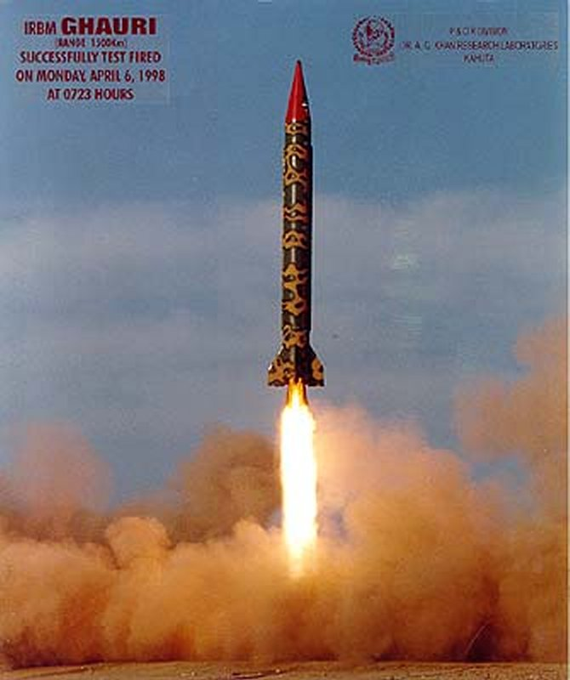
Where can we find the software?

Slide 13
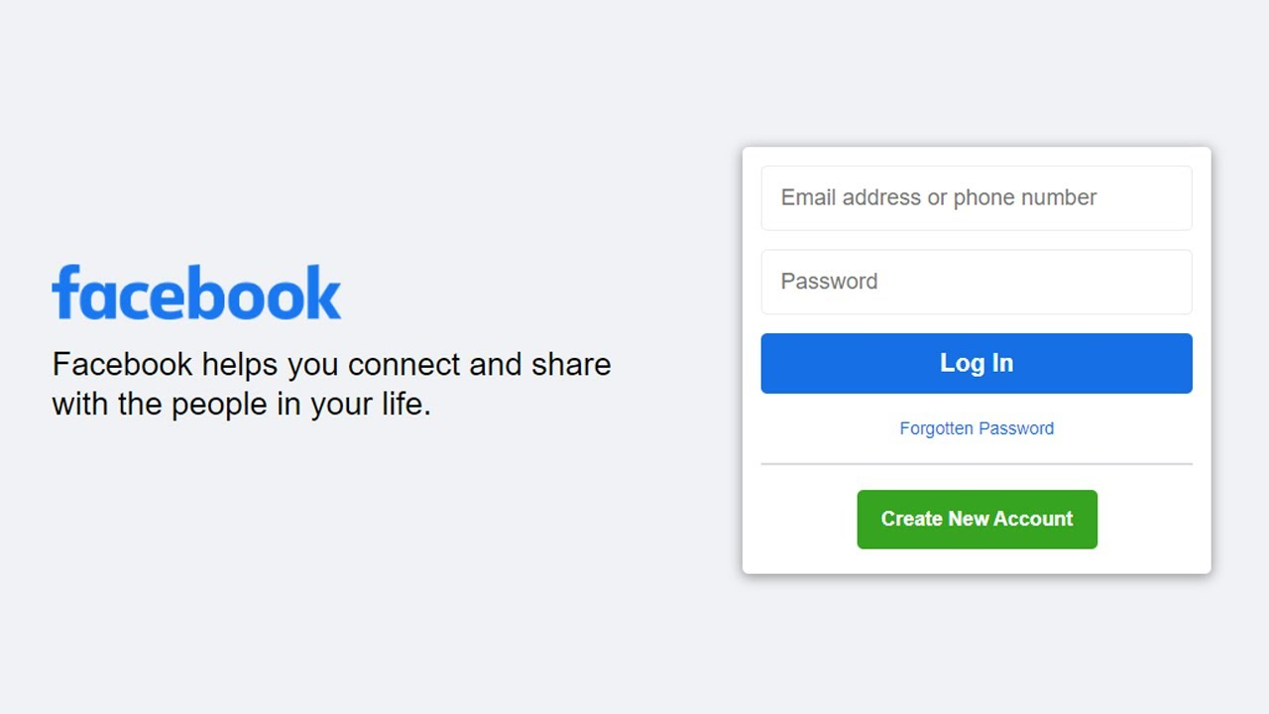
Some popular ones...

Slide 14
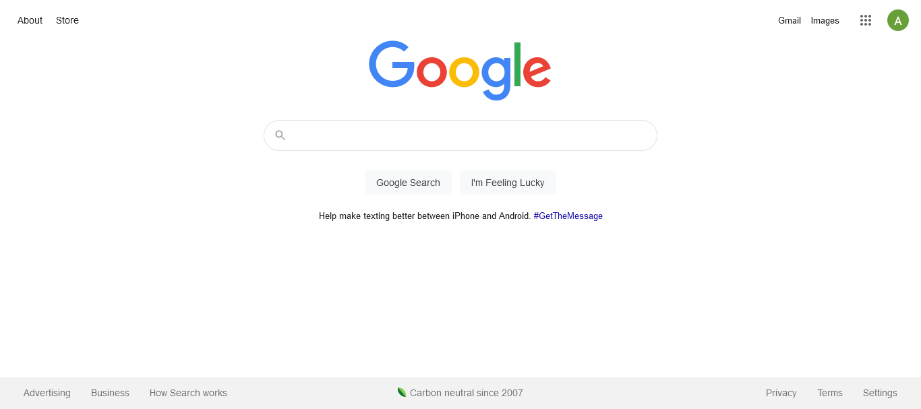
Some popular ones...

Slide 15
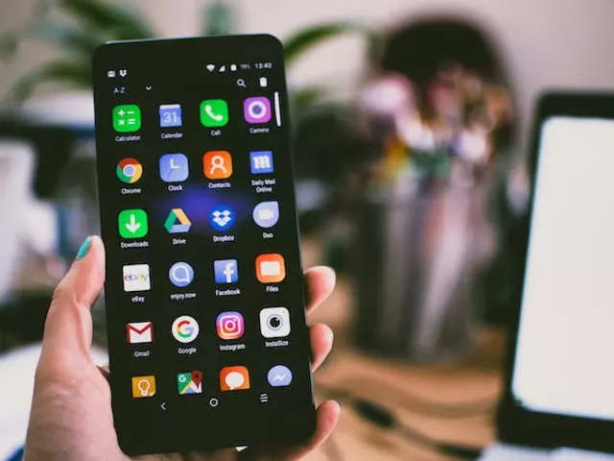
Some popular ones...

Slide 16
Conclusion
Software is Everywhere!

Slide 17
Software Crisis
About US$250 billions spent per year in the US on application development
Out of this, about US$140 billions wasted due to the projects getting abandoned or reworked; this in turn because of not following best practices and standards
Ref: Standish Group, 1996

Slide 18
Ariane 5 Flight 501
Cause: Design errors in the system
https://www.youtube.com/watch?v=W3YJeoYgozw

Slide 19
Problems in Software Development
Software products:
  Fail to meet user requirements (London Ambulance System)
  Hard to Extend/Improve
  Bad Documentation
  Bad Quality
  More time & Cost than expected

Slide 20
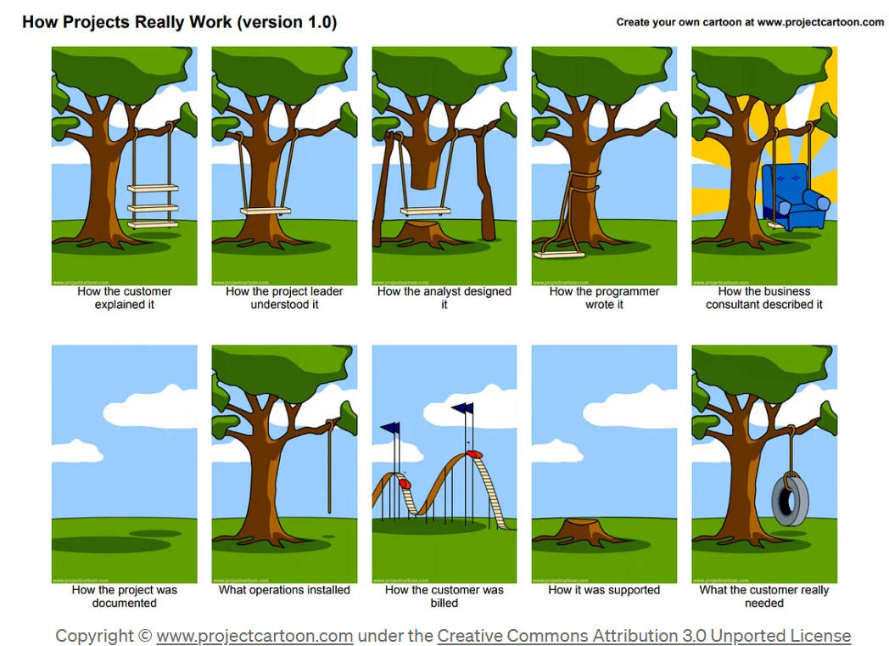

Slide 21
A Good Software Engineer Avoids Problem
A clever person solves a problem,
A wise person avoids it!
Albert Einstein

Slide 22
Solution
SOFTWARE ENGINEERING

Slide 23
What is software?
Software is a set of instructions, data, or programs that enable a computer to perform specific tasks.
Software products may be developed for a particular customer or may be developed for a general market
Software products may be
  Generic - developed to be sold to a range of different customers
  Specific (custom) - developed for a single customer according to their specification

Slide 24
Types of Software
Software is mainly divided into two categories:
System software
  Systems software includes the programs that are dedicated to managing the computer itself, such as the operating system.
Application software
  Application software, or simply applications, are often called end-user programs because they enable the user to complete tasks, such as creating documents, specific to the task it is designed e.g. word processing software
  More examples?
Notes:
Systems software such as the operating system, file management utilities, and disk operating system (or DOS). The operating system manages the computer hardware resources in addition to applications and data. Without systems software installed in our computers we would have to type the instructions for everything we wanted the computer to do!
A software suite or application suite is a collection of computer programs (google docs, calendar, google+, mail)
Application software such as creating documents, spreadsheets, databases and publications, doing online research, sending email, designing graphics, running businesses, and even playing games! Application software is specific to the task it is designed for and can be as simple as a calculator application or as complex as a word processing application. When you begin creating a document, the word processing software has already set the margins, font style and size, and the line spacing for you. But you can change these settings, and you have many more formatting options available.

Slide 25
Software Engineering: Definition
Software engineering is the systematic approach to designing, developing, testing, deploying, and maintaining software applications.

Slide 26
Software Engineering: Definition
Software Engineering is a collection of techniques, methodologies and tools that help with the production of
a high quality software system
with a given budget
before a given deadline
while change occurs.

Slide 27

What is software engineering?
Software engineering is an engineering discipline which is concerned with all aspects of software production
Software engineers should
adopt a systematic and organised approach to their work
use appropriate tools and techniques depending on
  the problem to be solved,
  the development constraints and
  the resources available

Slide 28
Software Engineering and
Computer Science?
This sums up software Engineering as
  “SE is the process of utilizing our knowledge of computer science in effective production of software systems.”

Slide 29
Computer Scientist vs Software Engineer
Computer Scientist
  Proves theorems about algorithms, designs languages, defines knowledge representation schemes
  Has infinite time…
Software Engineer
  Develops a solution for an application-specific problem for a client
  Uses computers & languages, tools, techniques and methods
  Has only 3 months... ☺
  …while changes occurs in requirements and available
technology

Slide 30
Software Process

Slide 31
Software Process
Communication
Planning
Modeling
Implementation
Deployment

Slide 32
Software Process
Communication: Before any technical work can commence, it is critically important to communicate and collaborate with the customer (and other stakeholders).
The intent is to understand stakeholders’ objectives for the project and to gather requirements that help define software features and functions.

Slide 33
Software Process
Planning: A software project is a complicated journey, and the planning activity creates a “map” that helps guide the team as it makes the journey.
The map—called a software project plan—defines the software engineering work by describing the technical tasks to be conducted, the risks that are likely, the resources that will be required, the work products to be produced, and a work schedule.

Slide 34
Software Process
Modelling: A software engineer creates models to better understand software requirements and the design that will achieve those requirements.

Slide 35
Software Process
Construction: This activity combines code generation (either manual or automated) and the testing that is required to uncover errors in the code.

Slide 36
Software Process
Deployment: The software (as a complete entity or as a partially completed increment) is delivered to the customer who evaluates the delivered product and provides feedback based on the evaluation

Slide 37
The End.

